Slide 1
QRNNs
https://arxiv.org/pdf/2302.03244.pdf

Slide 2
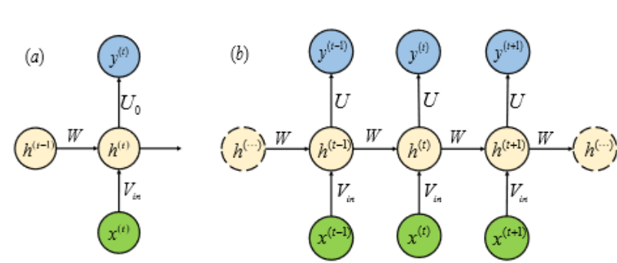
How Do RNNs work?
In RNNs, the output at a time step T is given by input at the current time step and the history of the past elements of the sequence.
(a) RNN Block
(b) RNN network

Slide 3
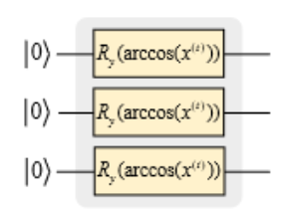
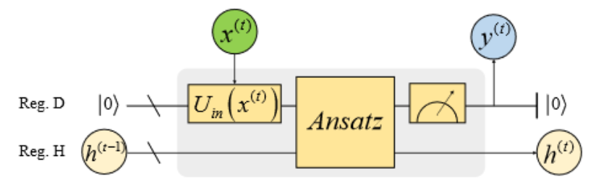
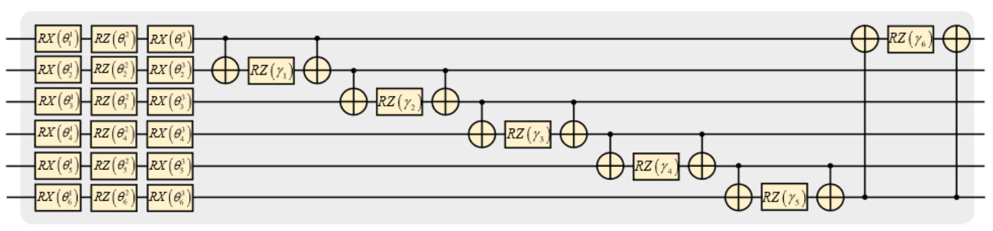
Proposed QRB in paper
The proposed QRB consists of three parts : data encoding, ansatz circuit and partial measurement
The paper uses angle encoding to encode data and feed to ansatz
The ansatz is hardware efficient which consists of layers of two qubit and single qubit gates
The rotation angles of the RZZ gates inside the ansatz are the learnable parameters
Circuit block config is used for the ansatz
QRB Block with encoding and ansatz

Slide 4
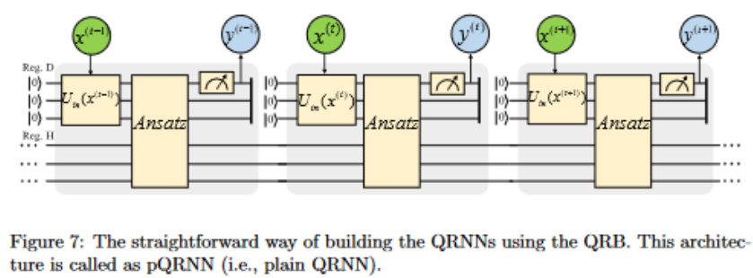
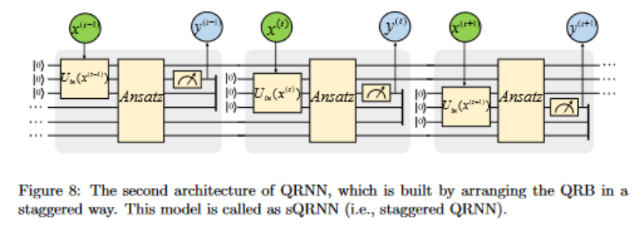
pQRNN and sQRNN:

Slide 5
How it is efficient
The staggered config allows the qubits to reset to zero after a long chain of recurrent blocks thus reducing coherence time and making it optimized for NISQ devices
QRNNs can predict acute variations better than classical RNNs
QRNNs use lesser parameters and computational cost than classical RNNs and QSANNs

Slide 6
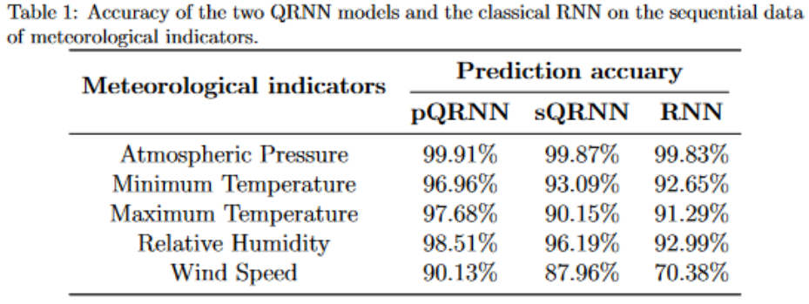
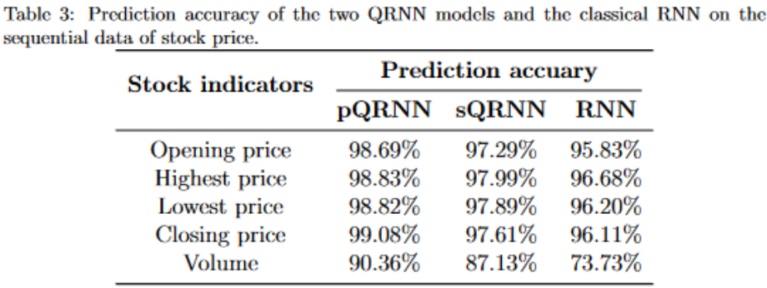
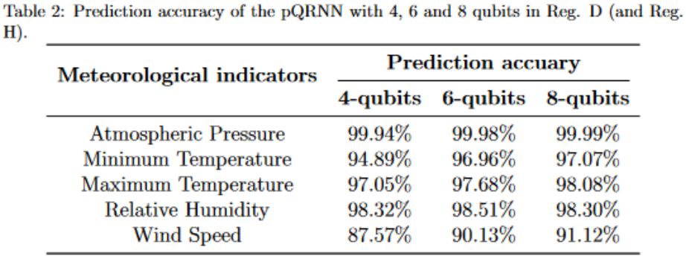
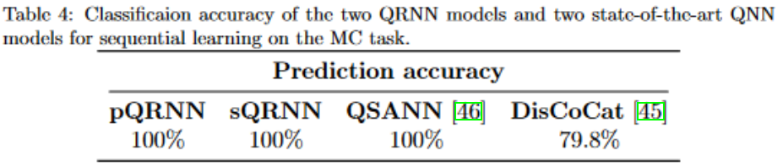
Result comparisons

